Slide 1
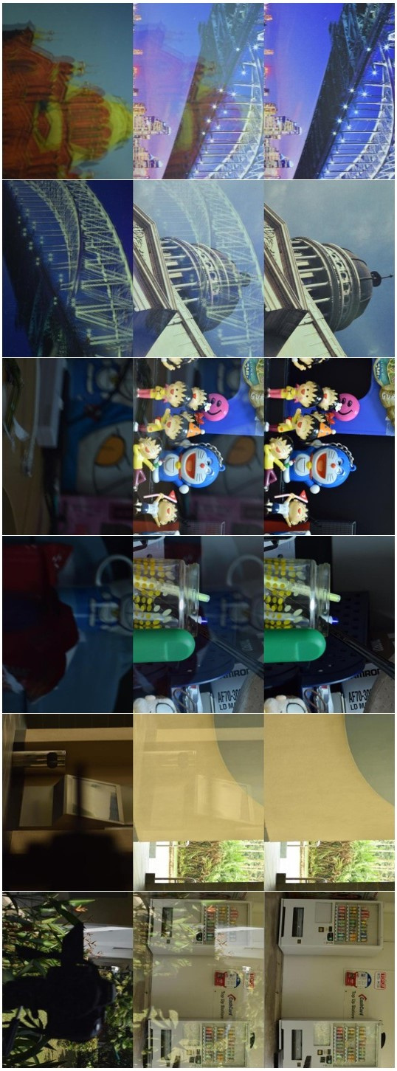

Removing Reflections from Images Using AI
In the realm of digital image processing, reflections pose a persistent challenge. They can occur when capturing images through reflective surfaces like glass or water, obscuring the desired subject and degrading the overall image quality. This project tackles this challenge by employing a deep learning approach, specifically a U-Net architecture, to automatically detect and remove reflections from images, restoring clarity and enhancing visual appeal.
Notes:
1

Slide 2
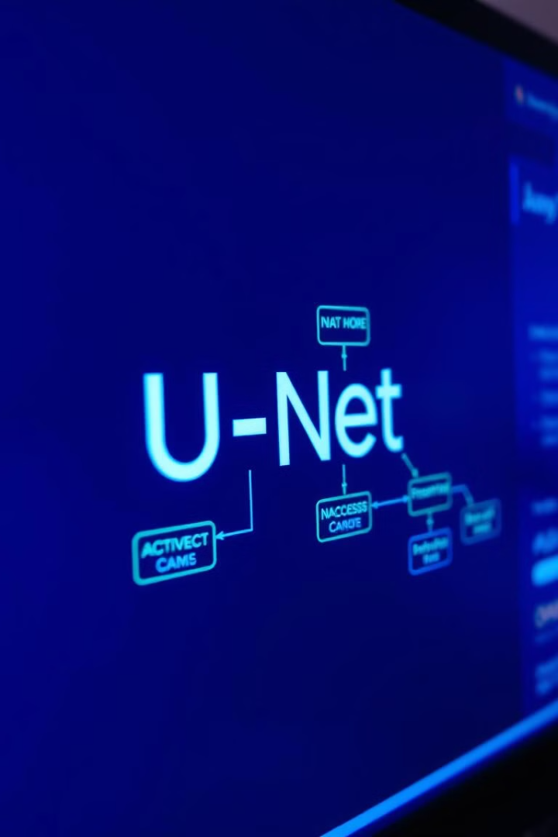
A Deep Learning Approach Using U-Net
Deep Learning
U-Net
Deep learning models are powerful tools for image processing tasks, capable of learning complex patterns from large datasets. These models, trained on numerous examples, can identify and remove reflections with high accuracy.
U-Net, a convolutional neural network architecture specifically designed for image-to-image tasks, excels at tasks like segmentation and restoration, making it an ideal choice for reflection removal.
Notes:
2

Slide 3
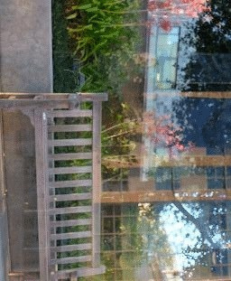
Problem Overview: Reflections Degrade Image Quality
1
Visual Distraction
2
Blurred Details
Reflections can be visually distracting, pulling attention away from the main subject of the image.
The presence of reflections often results in a blurry or distorted image, making it challenging to discern details.
3
Obscured Information
4
Color Distortion
Reflections can obscure or mask important features within an image, making it difficult to interpret the scene accurately.
Reflections can introduce unwanted color shifts or distortions, altering the natural color balance of the image.
Notes:
3

Slide 4
Motivation: Need for Automated Reflection Removal
Time-Consuming
Subjective Results
Automation Efficiency
Manually removing reflections from images is a time-consuming and labor-intensive process, requiring specialized software and skills.
Manual reflection removal often relies on subjective decisions, leading to inconsistent and sometimes unsatisfactory results.
Automated solutions offer a significant advantage by eliminating the need for manual intervention, enabling efficient and consistent reflection removal.
Notes:
4

Slide 5
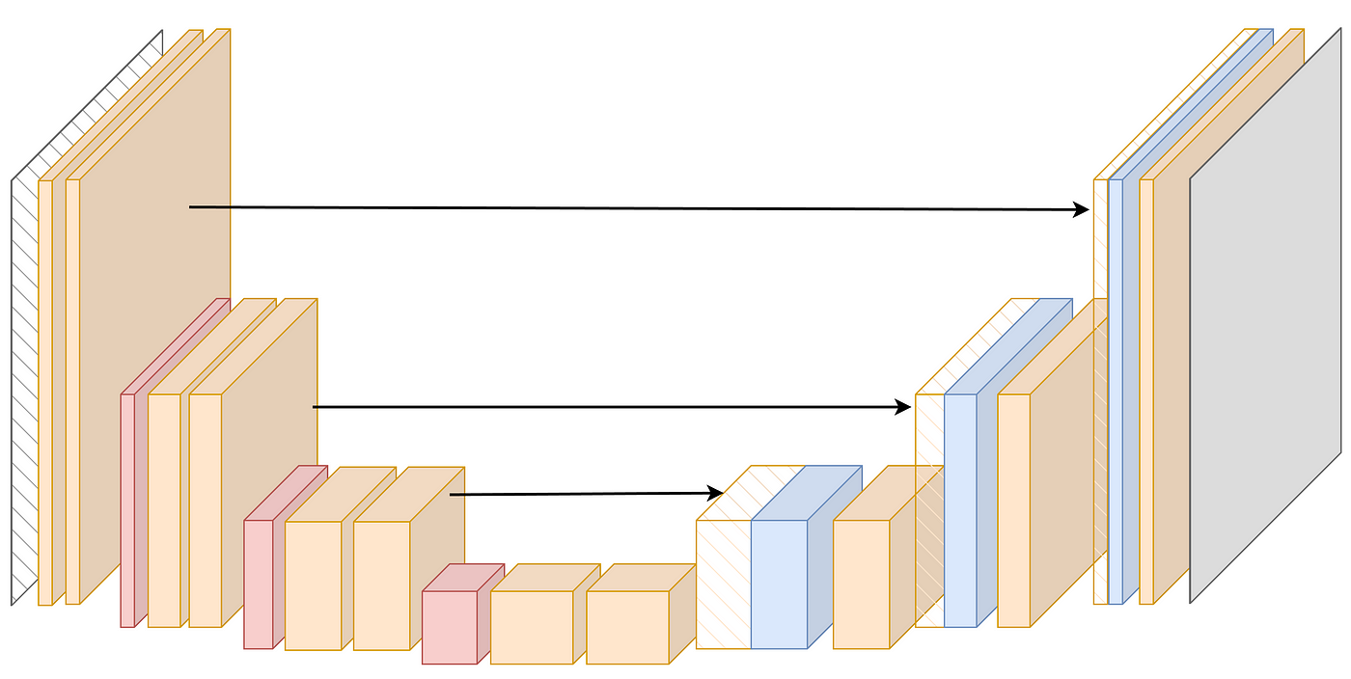
Introduction to U-Net: A Powerful Image-to-Image Model
U-Net, a convolutional neural network architecture, has gained prominence for its effectiveness in image-to-image tasks. It utilizes an encoder-decoder structure with skip connections, allowing it to capture and preserve intricate spatial information throughout the network. This unique design enables U-Net to achieve high-quality results in tasks like image segmentation, restoration, and object detection.
Notes:
5

Slide 6




U-Net Architecture: Encoder-Decoder with Skip Connections
Encoder
The encoder part of the U-Net gradually extracts features from the input image, downsampling the image using convolutional and pooling layers.
Decoder
The decoder part reconstructs the image using upsampling layers, incorporating features learned from the encoder through skip connections.
Skip Connections
Skip connections allow the decoder to access features extracted from the encoder at different scales, enhancing the quality and detail of the output image.
Notes:
6

Slide 7
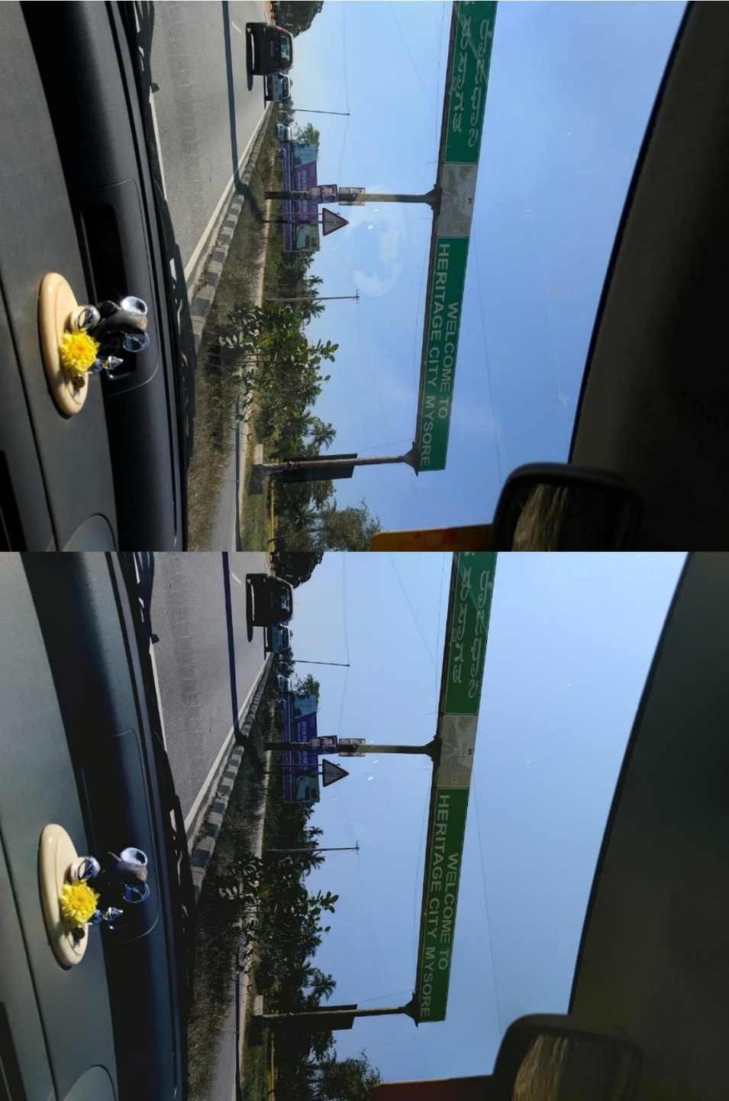
Dataset Preparation: Collecting and Annotating Reflection Images
Step 1: Data Collection
Gather a diverse dataset of images containing reflections, ensuring various lighting conditions, reflection patterns, and subject matter.
Step 2: Annotation
Manually label or annotate the reflection regions in each image, providing the model with ground truth information for training.
Step 3: Data Augmentation
Use techniques like rotation, flipping, and scaling to artificially expand the dataset, increasing the model's generalization ability.
Notes:
7

Slide 8
Dataset Preparation: Collecting and Annotating Reflection Images
Step 1: Data Collection
Gather a diverse dataset of images containing reflections, ensuring various lighting conditions, reflection patterns, and subject matter.
Step 2: Annotation
Manually label or annotate the reflection regions in each image, providing the model with ground truth information for training.
Step 3: Data Augmentation
Use techniques like rotation, flipping, and scaling to artificially expand the dataset, increasing the model's generalization ability.
Notes:
7

Slide 9
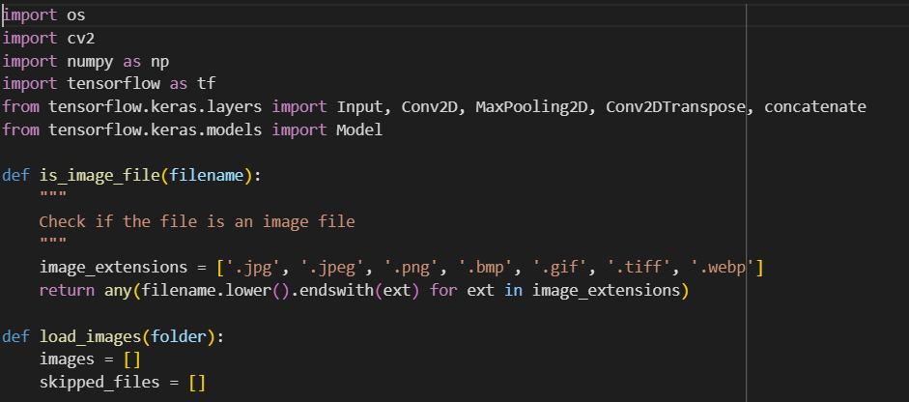
Importing Libraries
Notes:
8

Slide 10
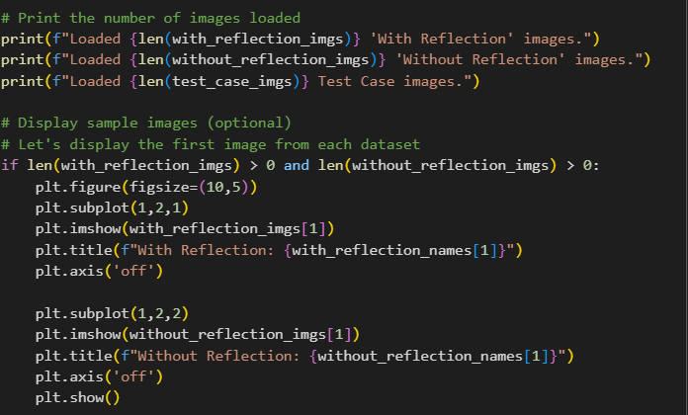
Notes:
8

Slide 11
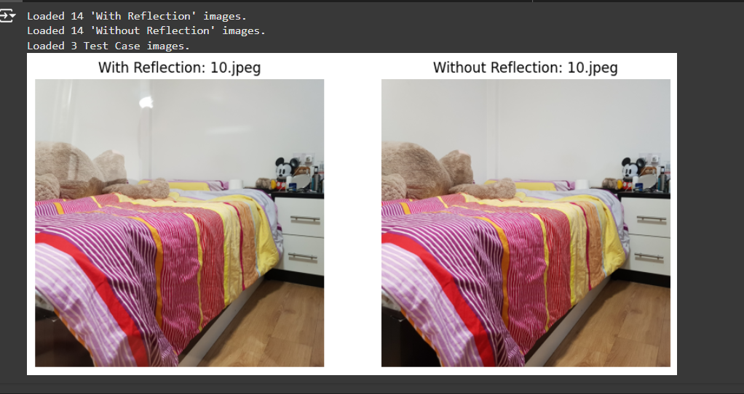
Notes:
8

Slide 12
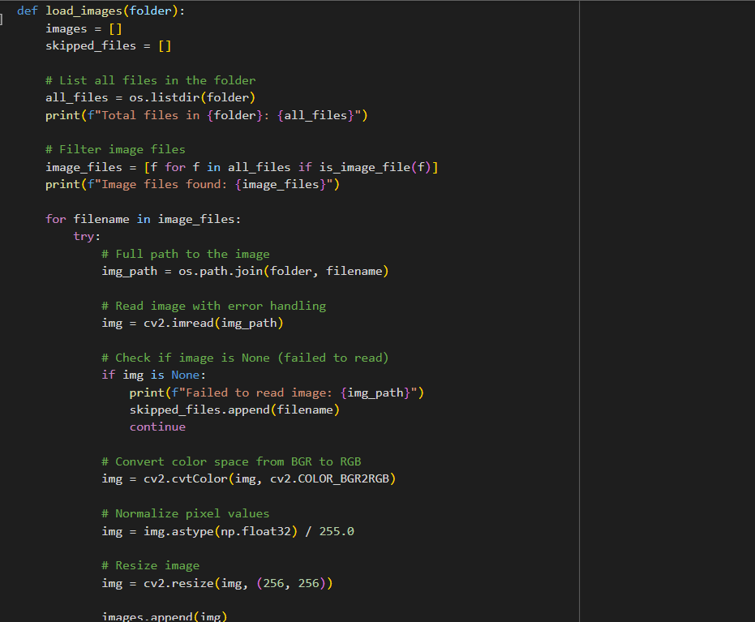
Notes:
8

Slide 13
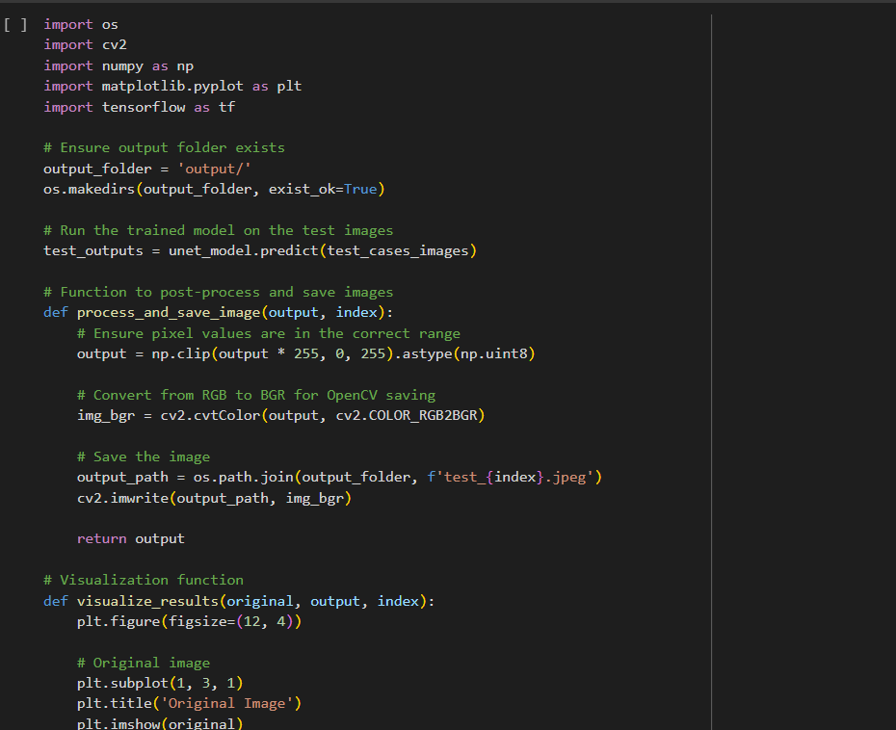
Notes:
8

Slide 14
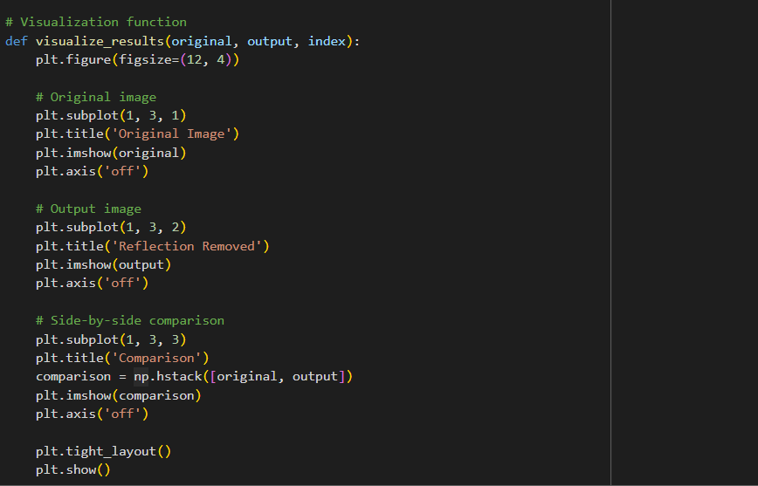
Notes:
8

Slide 15
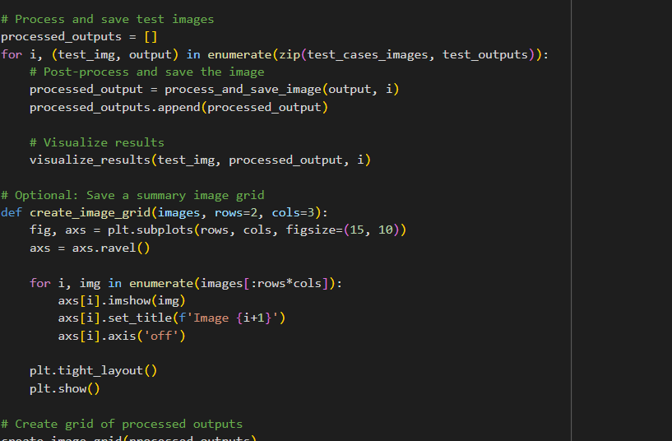
Notes:
8

Slide 16
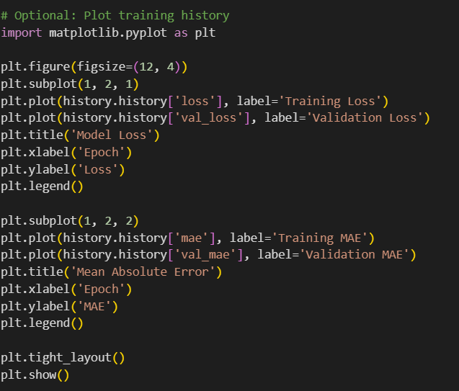
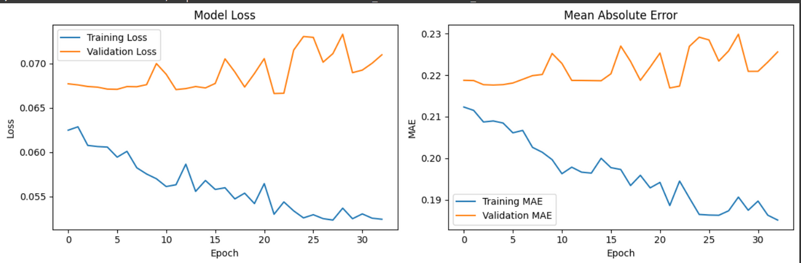
Notes:
8

Slide 17
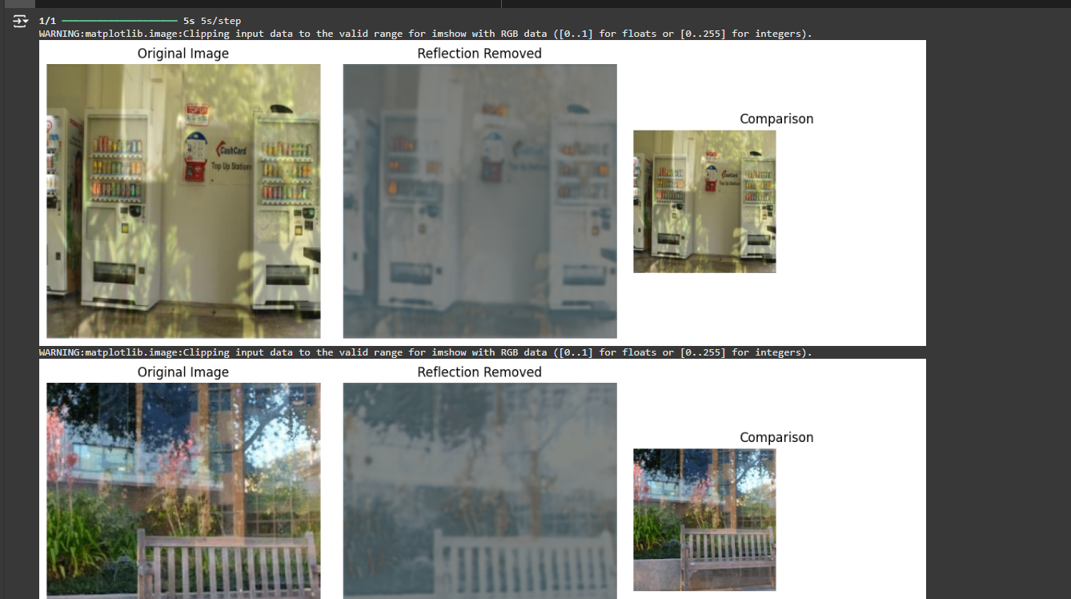
Final Output:
Notes:
8

Slide 18
Conclusion and Future Work: Improving Robustness and Real-World Applicability
This project successfully demonstrates the potential of deep learning, specifically U-Net, for removing reflections from images. The model achieves impressive results, effectively detecting and removing reflections while preserving image quality. Future work will focus on improving the model's robustness to handle various challenging scenarios, including complex reflection patterns and low-quality input images. Additionally, exploring the application of the model to real-world scenarios, such as mobile applications for enhancing photographs, will be a key area of research.
Notes:
10

Slide 19
